Slide 1
Enterprise Integration Patterns
Spring-integration
Notes:
1 - Transmite eventos do norma
2 - Responde a pedidos de uma aplicação externa
<number>

Slide 2



Slide 3
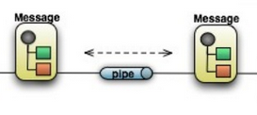
Core Messaging
Works by decoupling diverse systems
Different application need to share data
Fault tolerance – messages are queued and delivered when possible
JMS e AMQP offer powerful and robust solutions

Slide 4

Message
• A generic package for any kind of data (payload) which can be transported across channels (channels)
• Contains Headers which provide information to routing components. Example headers are:
– Sequence Number
– Sequence Size
– Expiration Date
– Correlation Identifier
– Return Address
– Transport Info
Header
Payload

Slide 5


Channel
MSG
MSG
Produtor
Consumidor
Decouples producers and consumers
Cannels can be:
- point-to-apoint
- publish-subscribe
point-to-point channel
publish-subscribe channel
Notes:
Ponto a ponto – se houver mais do que um consumidor, só um deles recebe a mensagem.
Publica-ubscreve – todos os consumidores recebem a mensagem enviada.
<number>

Slide 6

Translator/ Transformer
MSG
MSG’
Payload Transformer – converts the message type or its format
Header Transformer – Add or remove headers

Slide 7


Header Enricher
A specialized transformer to add missing data to a message
Notes:
How do we communicate with another system if the message originator does not have all the required data items available
<number>

Slide 8


Splitter & Aggregator
msg
msg
Request
Reply
msg
msg
msg
msg
Splits large messages into sub-messages
Delegates to several endpoints as needed
Aggregates messages from asynchronous responses

Slide 9


Router
VIP
MSG
Standard
Determines the target channel from:
- A header property value
- The type of payload
- The return value of a service call

Slide 10

Filter
MSG
MSG
Type of router that removes unwanted messages from a channel based on some criteria

Slide 11

Wire-Tap
MSG
MSG
MSG
Intercepts one channel and sends copies of the passing messages to another channel

Slide 12

Service Activator
request
Service
reply
Endpoint que chama um serviço
Suporta varios estilos de comunicação
- one way / request-reply
- síncrono ou asíncrono
O serviço não sabe da existência do sistema de messaging

Slide 13
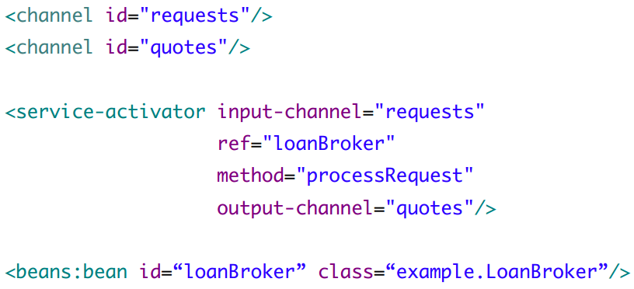
Service Activator

Slide 14




Adapters / Gateways
MS
Outbound adapter
Inbound adapter
External System
Internal App
Inbound gateway
Outbound gateway
Connect messaging systems to external systems
Can be inbound or outbound
Adapters are one-way
Gateways are request - reply

Slide 15
Spring Integration Adapters
Spring Integration offers de Adapters and Gateways for several systems entre os quais:
AMQP
JMS
RMI
Spring Application (events)
JDBC / JPA
HTTP
File, FTP
Mail, Twitter
Tibco
Web Services

Slide 16
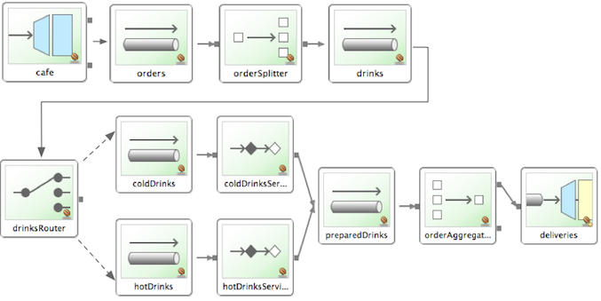
DEMO TIME
Example application - Barista
Notes:
<number>

Slide 17
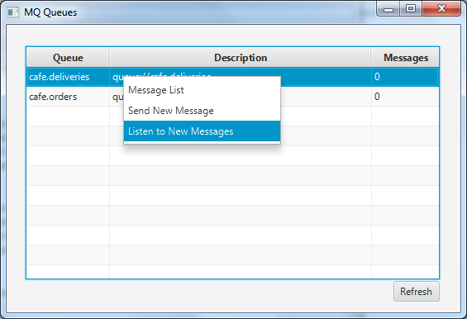
si-client

Slide 18
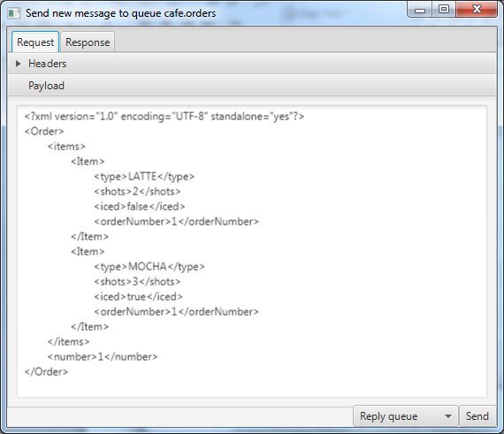
si-client

Slide 19
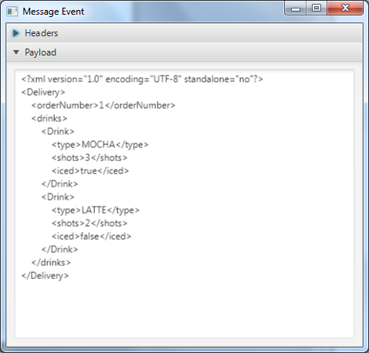
si-client

Slide 20
FIM

